Slide 1
The efferent system and our response to loud sounds
Ray Meddis
Essex University
Audiology Department, Royal surrey county Hospital

Slide 2
Auditory self regulation
The response of the auditory system to sounds is self-regulating
It uses a range of different systems to achieve this
Failure of any one of these systems could affect how aversive sounds will be

Slide 3
Response limiting systems
These regulating systems include the
  Acoustic reflex (AR)
  Medial-olivocochlear (MOC) reflex
  Lateral-olivocochlear (LOC) reflex
  Instantaneous compression of mechanical response
  Inner hair cell (IHC) receptor potential voltage limits
  Various brainstem inhibition systems
  ... and possibly a few others

Slide 4
Regulatory loops
Acoustic reflex
MOC reflex
middle ear
Basilar membrane
Inner hair cell
brainstem
Auditory nerve
compression
compression
LOC efferent system
inhibition
suppressive
excitatory

Slide 5
1. acoustic reflex properties
Action begins above 60 dB SPL
  Strongest for broadband sounds
Attenuation can be as great as 1 dB/dB above 80 dB SPL
AR motor neurons are broadly tuned
Operation is relatively slow by acoustic standards (30+ ms)
  Probably a protection against sustained loud sounds
Contralateral as well as ipsilateral effects
  May compute overall environment sound intensity

Slide 6
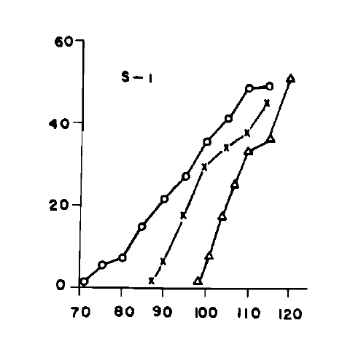
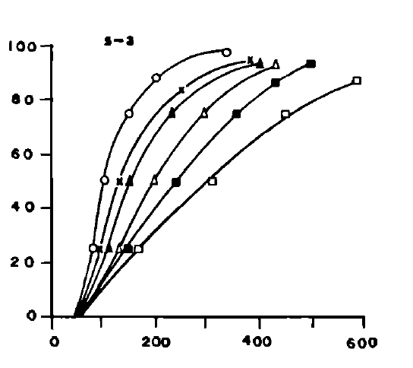
Acoustic reflex
High threshold relatively slow
115 dB SPL
90 dB SPL
Impedence change
Impedence change
% of maximum
level
Time (msec)
Hung and Dallos 1972

Slide 7
2. MOC suppression of BM response
Acts is through outer hair cells (OHCs)
  If OHC is dysfunctional, this cannot operate
Begins to operate close to hearing threshold
Narrowly tuned (compared to AR)
  Local operation (source and target basilar membrane (BM) regions overlap
Can be controlled by from inferior colliculus (IC)
  e.g. triggering in anticipation (e.g. Swallowing)
Contralateral as well as ipsilateral effects

Slide 8
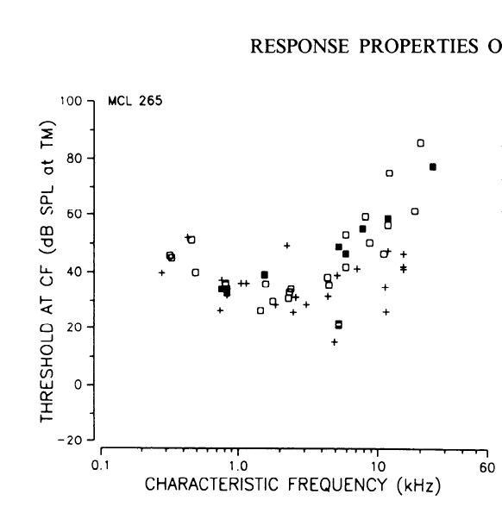
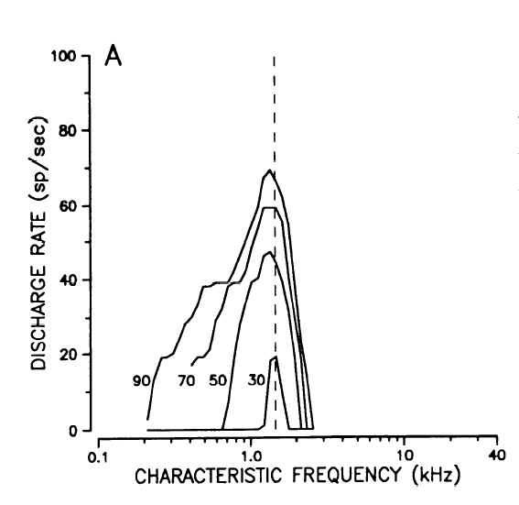
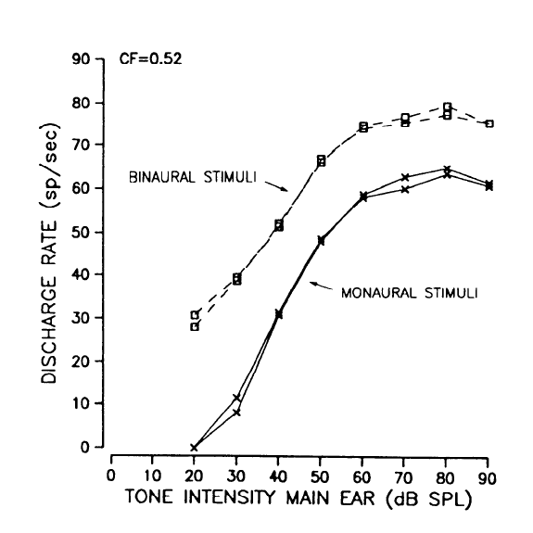
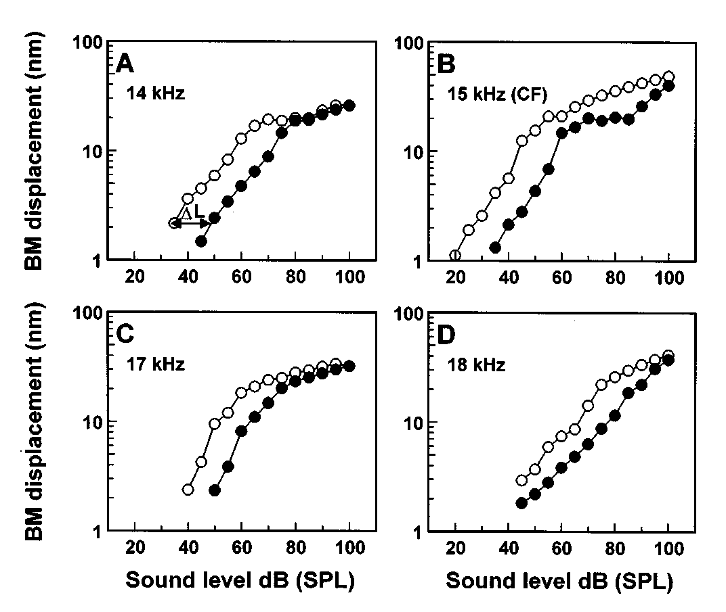
Thresholds tuning curves
MOC efferents
Rate/ level basilar membrane displacement
Liberman (1988) Russel and Murugasu 1996

Slide 9
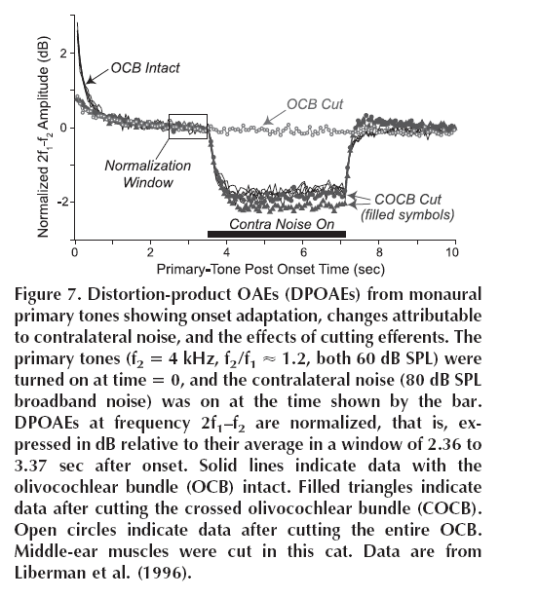

Slide 10
3. LOC Lateral-olivocochlear reflex
This system is not well understood.
It consists of descending fibers that make contact with the auditory nerve close to IHC but post-synaptic.
It can be both excitatory and inhibitory
  Up to 6 different neuro-transmitters may be involved
Largely mysterious but potentially very important

Slide 11
4. Instantaneous compression
Basilar membrane (BM) response is linear up to about 20 dB SL.
Above 20 dB SL, severe compression applies
  2 dB output for 10 dB input
This effect depends on the integrity of outer hair cells (OHCs)
  It is lost in some types of sensory neural impairment

Slide 12
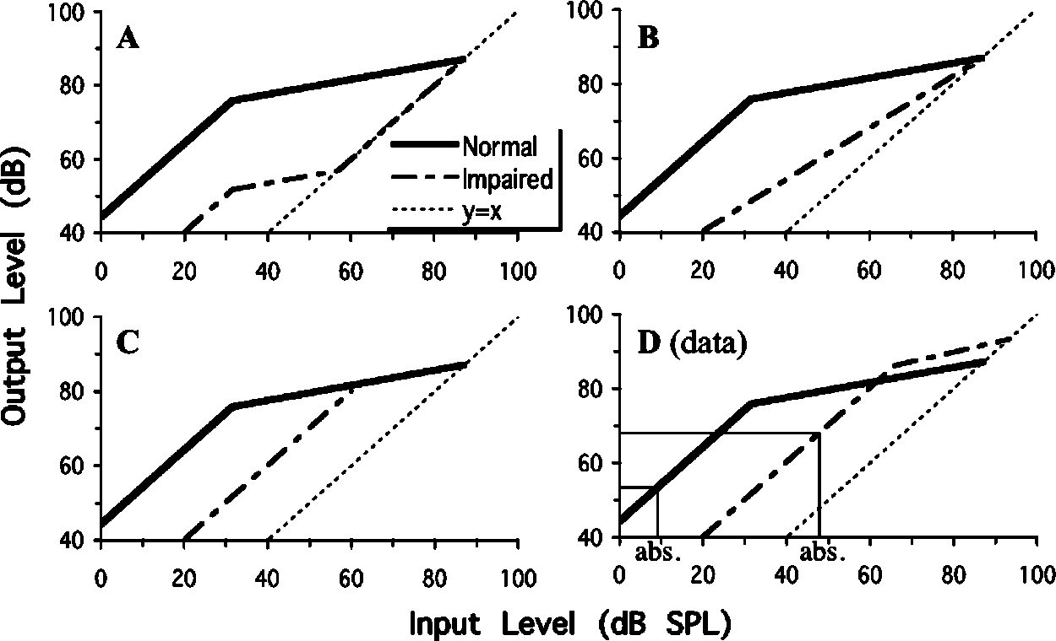
Three ways in which hearing impairment may affect compression.
(Plack and Lopez-Poveda 2004)

Slide 13
5. Inner hair cell (IHC) compression
The receptor potential operates in a narrow range (say 30 mV)
IHC receptor potential is approximately linear up to 70 dB SPL then it hits a ceiling
  Severely compressed above that
  If gain is reduced in impairment, the ceiling may never be reached and the response will be linear throughout

Slide 14
6. Brainstem inhibition
Projection neurons in cochlear nucleus (CN) are subject to inhibition
On-frequency (narrowband inhibition)
  Has been linked with echo-suppression
Off-frequency (wideband inhibition)
  May be useful in noisy environments
Inhibition may be less active with ageing

Slide 15
Function ?
The debate continues but possibilities include
Keeping the system response within some useful operating range
  useful at cocktail parties, conference dinners
  inhibiting unwanted sounds, e.g. Swallowing, coughing, etc.
  (? Wideband suppression)
Attention:
  selective attention
  (? Narrowband suppression and excitation)

Slide 16
Conclusion
There are many process that regulate the strength of the response to sounds
  Most are suppressive
There is a lot to go wrong. In a feedback loop the problem can lie either ...
  By failure of a system component
  As the result of a failure of the input to the feedback loop.

